Slide 1


DEPARTMENT OF MECHANICAL ENGINEERING
RESEARCH OF RECHARGABLE ELECTRIC VEHICLE
TEAM MEMBERS: GUIDED BY:
Kiruthika S (927622BME041) Dr.S.Padmavathy
Krithik S (927622BME043) Associate professor/Mech
Lalithraj R (927622BME044)

Slide 2
PRESENTATION OUTLINE
Abstract
Introduction
Working
Materials Required
Conclusion

Slide 3
ABSTRACT
Rechargeable electric vehicles (EVs) have quickly become a key solution to reduce emissions and address climate change by providing a cleaner alternative to internal combustion engine vehicles.
Relying primarily on lithium-ion batteries, EVs can be recharged from external power sources, offering significant environmental benefits.
This paper explores the development, challenges, and future prospects of rechargeable EVs, focusing on battery technologies, charging infrastructure, and energy management systems.

Slide 4
Charging infrastructure is critical to EV adoption, with fast-charging stations reducing range anxiety among consumers.
However, these stations require considerable power, impacting the existing grid. Modernizing grids and integrating renewable energy will be essential for supporting EV growth sustainably.
This paper also addresses the environmental and economic impacts of EVs. Environmentally, EVs significantly reduce greenhouse gas emissions when powered by renewables, but challenges remain in battery recycling and disposal.
Economically, while initial costs are high, declining battery prices and government incentives are making EVs more accessible.
As battery costs decrease, EVs are expected to achieve cost parity with traditional vehicles in the near future.

Slide 5
INTRODUCTION
Rechargeable electric vehicles (EVs) have emerged as a pivotal innovation in the transportation sector, driven by the need to reduce carbon emissions and mitigate the effects of climate change.
Unlike conventional vehicles that rely on fossil fuels, EVs are powered by rechargeable battery systems, offering a cleaner and more sustainable alternative. With advancements in battery technology, energy management, and charging infrastructure, EVs are becoming increasingly viable for both personal and commercial use, showing promise as a cornerstone of future mobility.
However, the widespread adoption of EVs is still constrained by several challenges, including high battery costs, limited driving range, and the need for extensive and accessible charging networks. Addressing these challenges is essential to make EVs a more practical, accessible, and attractive option for consumers.

Slide 6
This project aims to provide a comprehensive exploration of rechargeable electric vehicles, focusing on three key areas: battery technologies, charging infrastructure, and energy management systems.
By analyzing lithium-ion and emerging battery alternatives like solid-state and lithium-sulfur, this project assesses the current capabilities and limitations of EV batteries, such as their range, lifespan, and cost. The project also investigates the evolution of charging infrastructure, including fast-charging technologies, wireless charging, and the impact of EVs on the electric grid.
Integrating renewable energy sources into the charging ecosystem is another focus, aiming to enhance the sustainability of EVs.Furthermore, this project examines the environmental and economic impacts of EV adoption, highlighting their potential to significantly reduce greenhouse

Slide 7
WORKING
Creating a self-recharging or range-extended electric bike (e-bike) using a generator involves a blend of strategic planning and technical design. The first step is defining clear project objectives, such as determining if the bike will be fully self-sustaining or simply use the generator to extend the battery's range.
Components include a high-capacity battery pack to store energy, a lightweight generator (commonly gasoline-powered or pedal-powered), and an efficient electric motor, either hub or mid-drive, to power the bike.
Selecting these components carefully is essential for maximizing efficiency and achieving a balanced system that won’t add excessive weight.A charge controller is a crucial element to manage the flow of energy from the generator to the battery. This component regulates charging, prevents overcharging, and ensures power flows efficiently without damaging the battery.

Slide 8
The generator can be programmed to charge the battery only when needed, such as during flat or downhill sections, or when battery levels drop below a certain threshold. An automated disengagement system can disconnect the generator when it’s unnecessary, which will reduce drag and improve rider comfort.
Once all components are installed, comprehensive testing is essential to evaluate the efficiency of the self-charging mechanism, battery range improvements, and overall performance. Testing can reveal areas for optimization, such as adjusting when the generator activates or improving power flow. Ensuring that the e-bike meets local regulations is also a priority, as there may be restrictions on generator-equipped e-bikes.
Safety measures are integral to the design, including secure mounting of the generator, insulation for electrical components, and easy access for maintenance. Overall, this project creates a framework for developing a generator-assisted e-bike, offering extended range, self-charging capabilities, and a greener transportation alternative suitable for longer rides and varied terrain.

Slide 9
MATERIALS REQUIRED
➢
➢BLDC motor
➢Fenix ARB ion Rechargeable Battery
➢ERHIndia 5Pc DC Dynamo Generator
➢Motor Controller
➢Alternator
➢Throttle
Chain Driv

Slide 10
BLDC MOTOR:
A BLDC (Brushless DC) motor operates without brushes, using permanent magnets and an electronic controller for efficient, precise motion. It offers higher efficiency, longer lifespan, and less maintenance compared to brushed motors. Common applications include electric vehicles, drones, and robotics.

Slide 11

Fenix ARB ion Rechargeable Battery:
The Fenix ARB-Ion Rechargeable Battery is a high-performance lithium-ion battery designed for use in Fenix flashlights and other devices. It provides a reliable power source with a high capacity, ensuring long runtimes and efficient energy usage. This rechargeable battery is designed for multiple charge cycles, offering convenience and sustainability.

Slide 12
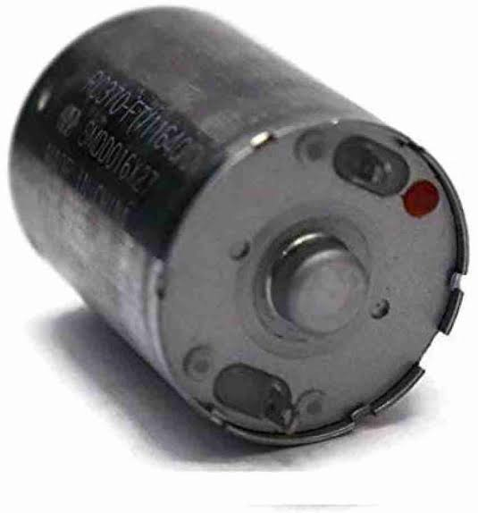
ERHIndia 5Pc DC Dynamo Generator:
The ERhIndia 5Pc DC Dynamo Generator is a small, efficient generator that converts mechanical energy into DC electricity. It is ideal for low-power applications, such as powering small devices or charging batteries. Perfect for DIY projects, educational purposes, and sustainable energy solutions.
Motor Controller :
A motor controller is an electronic device that manages the operation of an electric motor by regulating its speed, direction, and torque. It controls the power supplied to the motor, ensuring efficient performance. Motor controllers are essential in applications like robotics, electric vehicles, and industrial machinery.

Slide 13
Alternator:
An alternator is a device that converts mechanical energy into alternating current (AC) electricity. It is commonly used in vehicles and power generation systems to charge batteries and power electrical systems. Alternators are more efficient than DC generators, providing a continuous supply of electricity at varying speeds.
Throttle :
A throttle in an electric vehicle (EV) is a control mechanism that regulates the motor's power output based on the rider’s input. It adjusts the speed of the vehicle by controlling the flow of electrical current to the motor. Throttles can be either twist, thumb, or pedal-operated, providing smooth acceleration.

Slide 14
Chain Drive:
A chain drive in an electric vehicle (EV) is a mechanical system that transmits power from the motor to the wheels using a chain, sprockets, and gears. It offers a direct and efficient power transfer, commonly found in e-bikes and e-scooters. Chain drives are durable, cost-effective, and provide reliable performance, though they may require regular maintenance to ensure smooth operation.

Slide 15
CONCLUSION
In conclusion, the project titled "Research on Rechargeable Electric Bike Using Generator" offers valuable insights into enhancing the performance and sustainability of electric bikes. The integration of a generator into the bike’s power system allows for the conversion of mechanical energy into electrical energy during operation, effectively recharging the battery while the bike is in motion. This unique feature significantly extends the bike’s range, reducing the need for frequent external charging and enhancing the convenience of longer rides, especially in remote areas where charging stations may be scarce.
The research further highlights the cost-efficiency of this system, as it lowers the overall charging costs and minimizes the need for external power sources. Riders can benefit from the increased autonomy provided by the generator, allowing for uninterrupted travel and greater flexibility in their transportation options. Additionally, the integration of a controller ensures that the system operates efficiently, managing the flow of energy to avoid overcharging and optimizing power distribution.

Slide 16
THANK YOU

